Slide 1

Actuarial Data Science: R in Insurance
Data Analytics Day
November 2019
Yuan Tian

Slide 2

Agenda
Why R
Example of using R in Insurance
Pricing
Reserving
Data Visualisation
Linking to Excel, Access Database,SQL
Learning resources and next steps
Hands-on session with short exercises

Slide 3

Why R
Popular choice for actuaries ,scientists and academics
Easy and fun to learn : coding not complex
Already been studied and developed by many actuaries
Many practical package exists : ChainLadder, GoogleVis, GLM…
New IFOA Exam Syllabus
Easy to share the output , e.g. writing reports, building dashboards
R Markdown : html, pdf, excel data…
R Shiny : interactive web tool
Free!
Data Science and Data Analytics skills :
MUST HAVE FOR ACTUARIES!

Slide 4
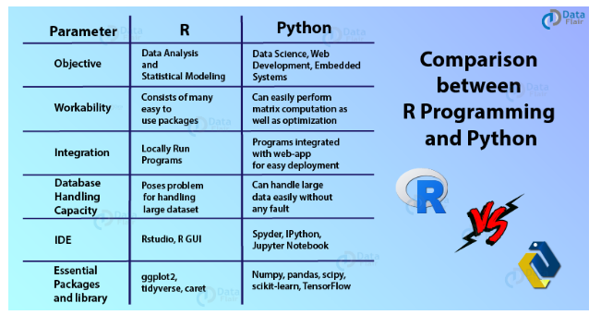
R vs Python
Python : multi-purpose programming language
R : statistical computing and graphical computation

Slide 5
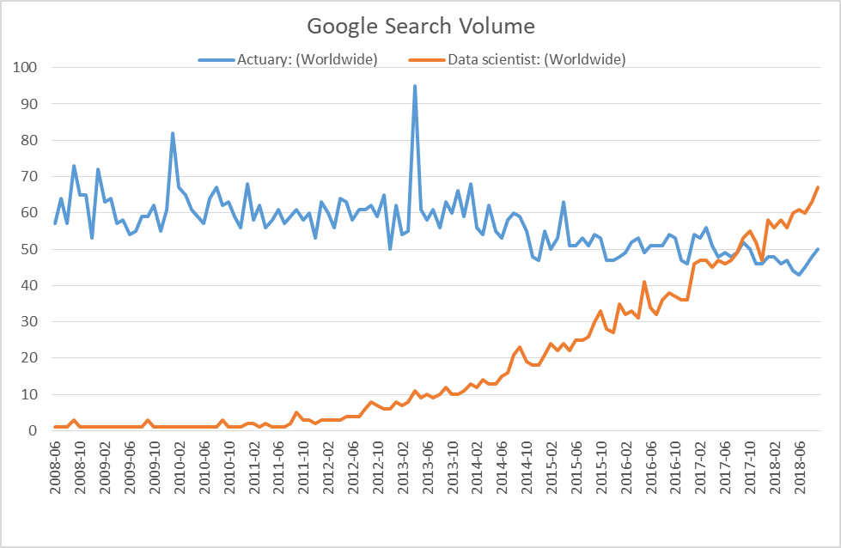
Actuary vs Data Scientist
Business Awareness, communicating insights to the business
Core technical actuarial skills
On going training , qualifications, CPD…
- Lack of :
Limited skills to deal with unstructured data
Large data analysis e.g web scraping
Visual representation ability
Programing skills
Google Trends as at Sept 2018
https://trends.google.com/trends/explore?date=all&q=Actuary,Data%20scientist

Slide 6

R Examples

Slide 7
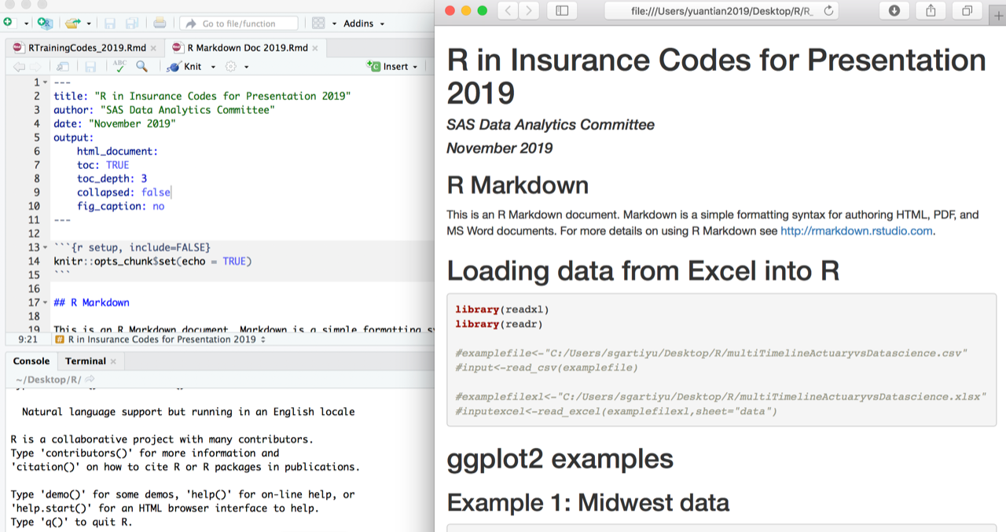
R examples - R Reporting RMarkdown
This package works in Rstudio allowing to add narrative text alongside a consistent set of exhibits
Reports have same structure every time
Actuaries concentrate on interpretation and narrative
Ad-hoc exhibits can be added to appendices and reproduced easily without adding workload
Reports can be output to Word, pdf, html
Attached in the Appendix
https://rmarkdown.rstudio.com/

Slide 8
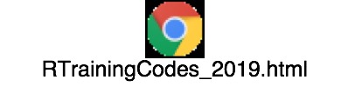

R examples - R Reporting RMarkdown
Open your Rstudio
Open this html file :
R Markdown Doc 2019.html
Try the examples!
Let’s do it together !
https://rmarkdown.rstudio.com/

Slide 9
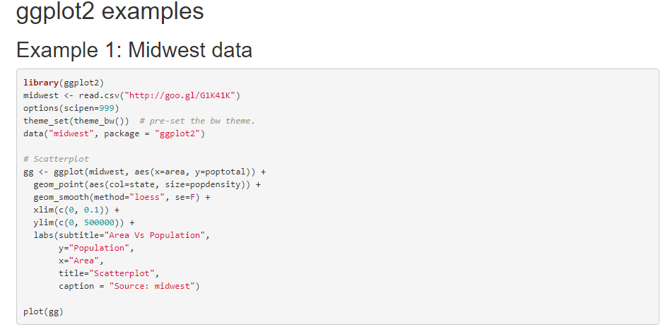
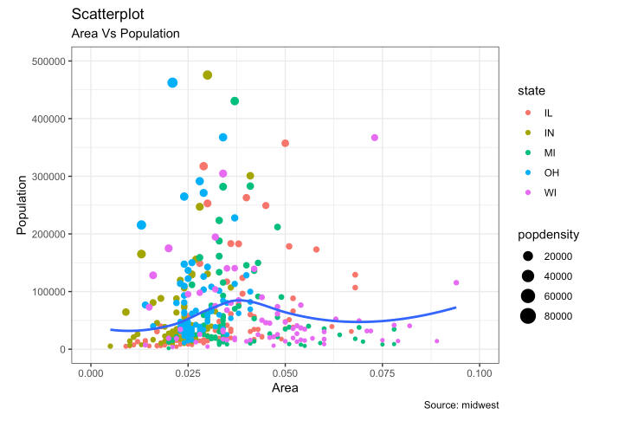
Let’s try this example together :
Source data and code : http://r-statistics.co/Top50-Ggplot2-Visualizations-MasterList-R-Code.html#top

Slide 10
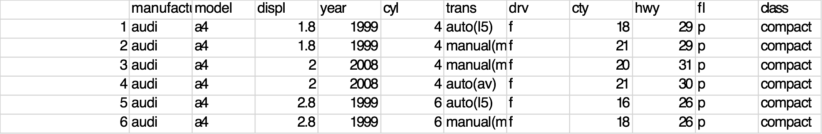
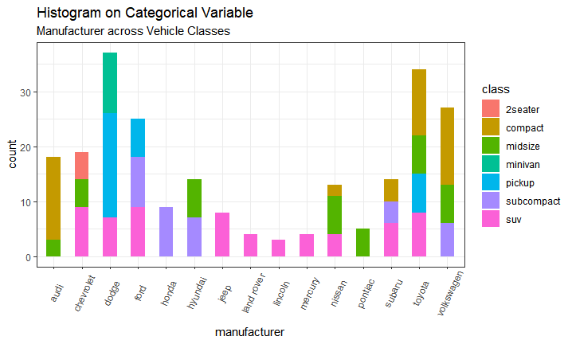
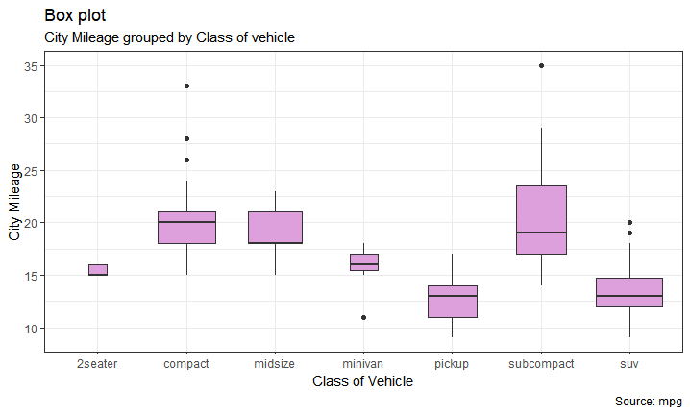
R examples - Data Visualization ggplot2
Source data and code : http://r-statistics.co/Top50-Ggplot2-Visualizations-MasterList-R-Code.html#top

Slide 11
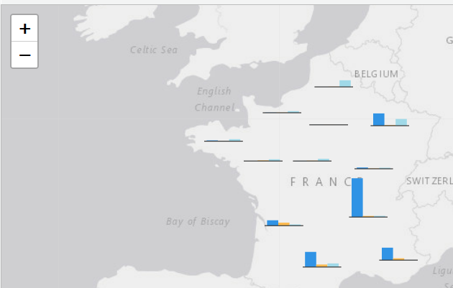
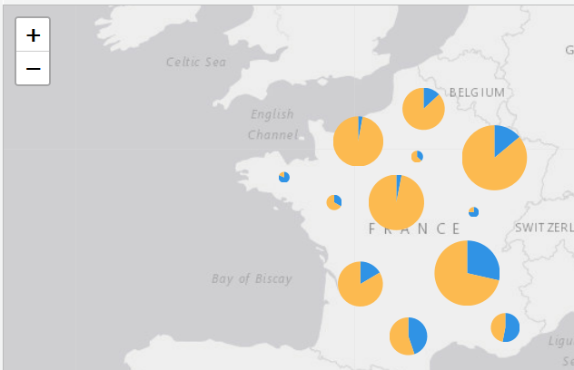
R examples - Data Visualization leaflet
Output Geographical Information to a map using leaflet package
Interactive maps allow zooming and slicing
Widely used in personal line motor pricing and Nat Cat perils aggregation management
https://cran.r-project.org/web/packages/leaflet.minicharts/vignettes/introduction.html

Slide 12
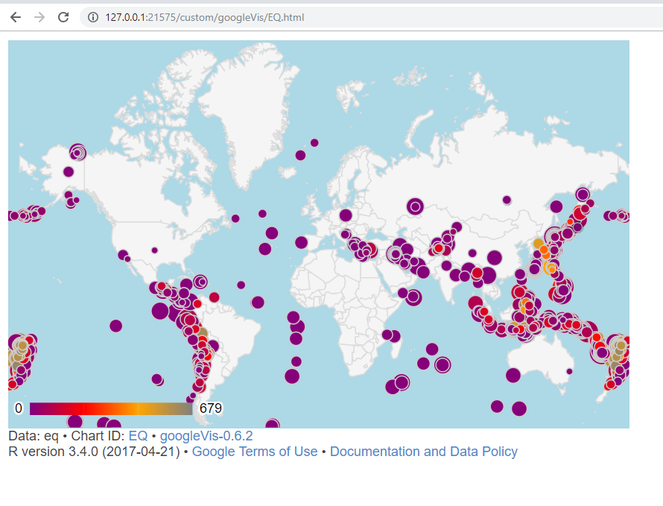
R examples - Data Visualization googleVis
Web interactive plot (use google chrome)
R interface to google chart
Author : Markus Gesmann (He is also the author of other actuarial R packages e.g. MBBEFD )
https://cran.r-project.org/web/packages/googleVis/vignettes/googleVis_examples.html

Slide 13
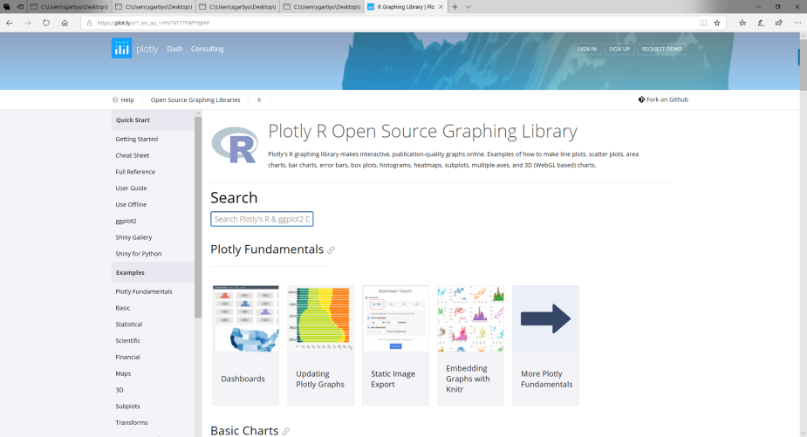
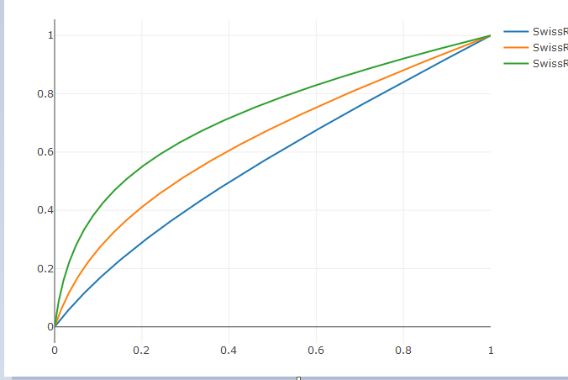
R examples - Data Visualization plotly
https://plot.ly/r/
Web interactive plot examples :
https://plot.ly/ggplot2/getting-started/#plotly-for-r

Slide 14
R examples - Pricing
The Basic R package : GLM
Package MGCV : GAM
Generalised Additive Models
Package XGBoost
Efficient linear model solver and tree learning algorithms
https://cran.r-project.org/web/packages/mgcv/mgcv.pdf
https://cran.r-project.org/web/packages/xgboost/index.html

Slide 15
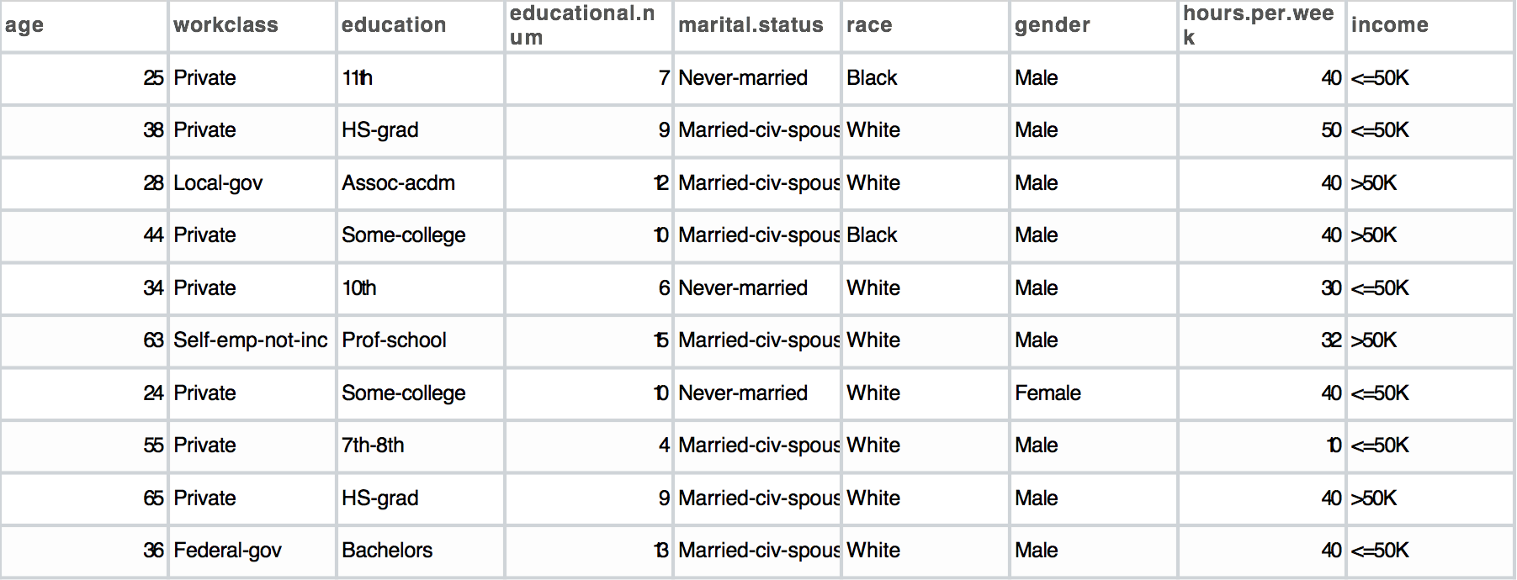
R examples - Pricing GLM
Dataset :
https://www.guru99.com/r-generalized-linear-model.html

Slide 16
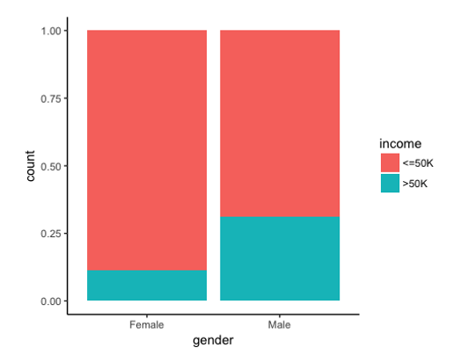
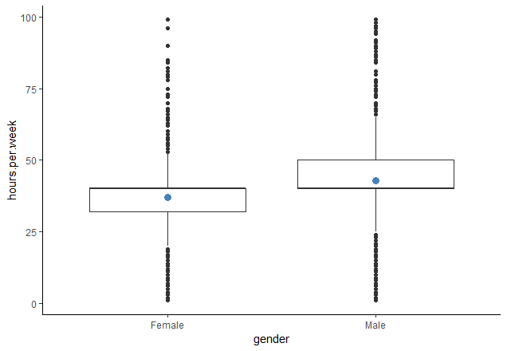
R examples - Pricing GLM
Checking Data Variables e.g. factor affect earnings , boxplot, variable correlation
https://www.guru99.com/r-generalized-linear-model.html

Slide 17
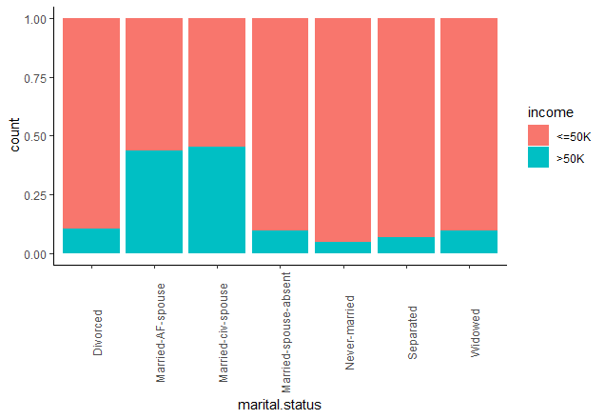
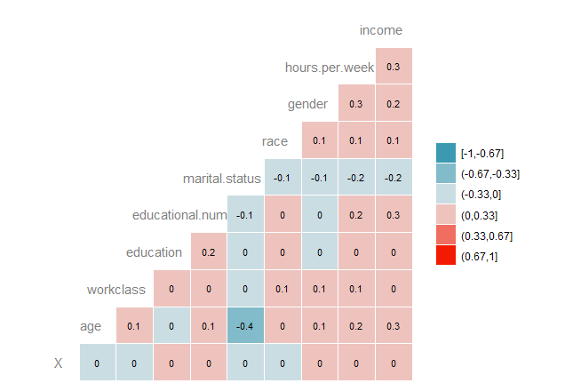
R examples - Pricing GLM
Checking Data Variables e.g. factor affect earnings , variable correlation
https://www.guru99.com/r-generalized-linear-model.html

Slide 18
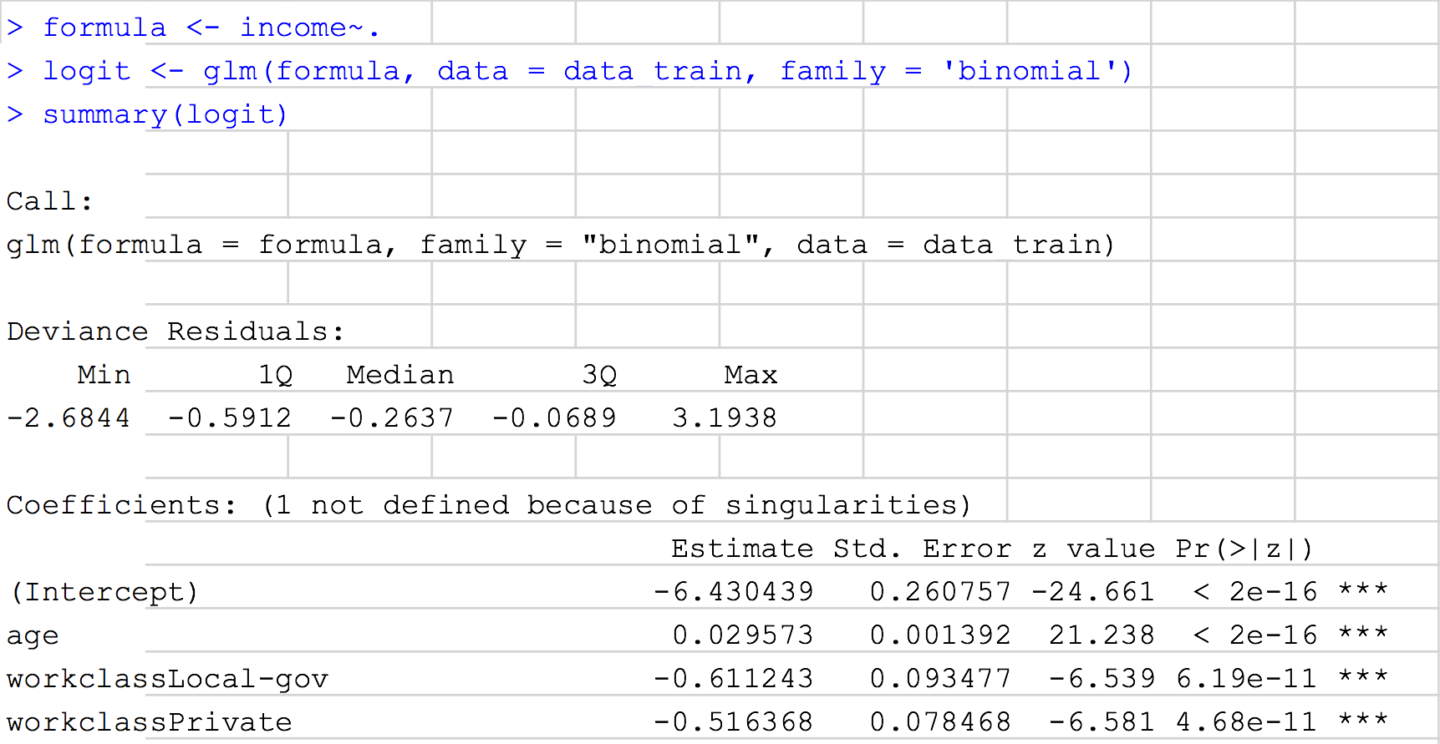
R examples - Pricing GLM
Using 80% 20% rule to split main dataset into train and test data
Using train data for model fitting
https://www.guru99.com/r-generalized-linear-model.html

Slide 19
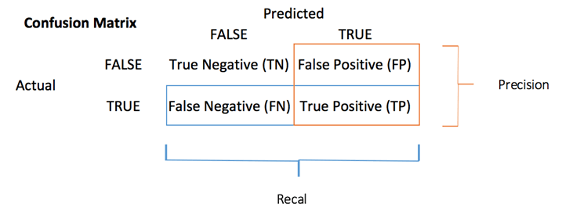
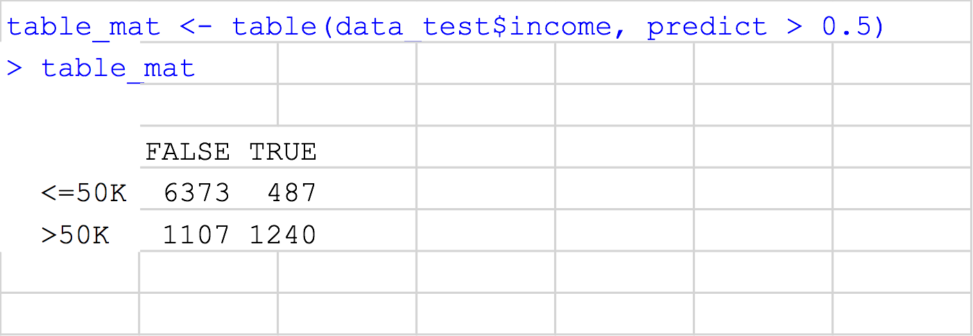

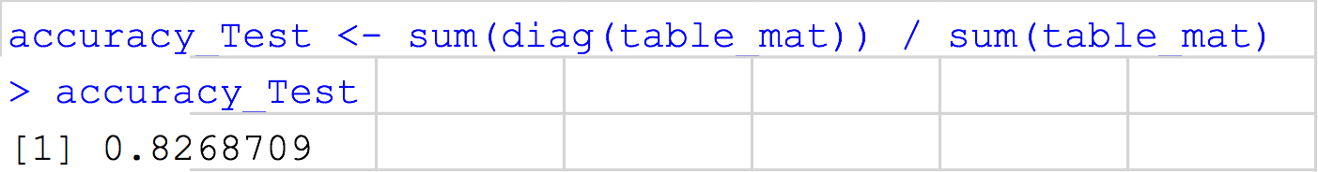
R examples - Pricing GLM
https://www.guru99.com/r-generalized-linear-model.html

Slide 20
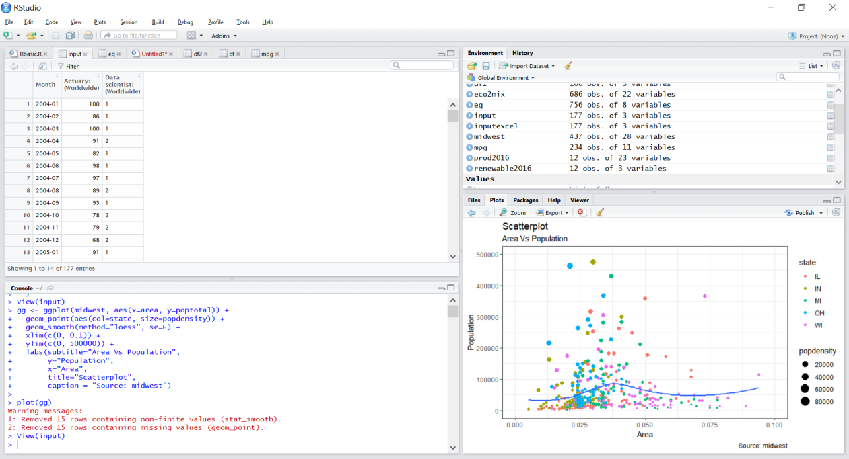
R examples - Data Processing and Manipulation in R
#Linking R to Excel
library(readxl)
library(readr)
examplefile<-"C:/Users/sgartiyu/Desktop/R/multiTimelineActuaryvsDatascience.csv"
input<-read_csv(examplefile)
examplefilexl<-"C:/Users/sgartiyu/Desktop/R/multiTimelineActuaryvsDatascience.xlsx"
inputexcel<-read_excel(examplefilexl,sheet="data")
#Linking R to SQL
library(odbc)
con <- dbConnect(odbc(),
Driver = "SQLServer",
Server = "mysqlhost",
Database = "mydbname",
UID = "myuser",
PWD = rstudioapi::askForPassword("Database password")
Port = 1433)
#Manipulation
#data manipulation
library(dplyr)
library(tidyr)
library(data.table)
Library(DT)

Slide 21
R examples - Reserving ChainLadder
The ChainLadder package written by Markus Gesmann allows standard reserving methods to be applied to development triangles
Chain Ladder
BF Cape Cod
Mack Method
Bootstrapping
…

Slide 22
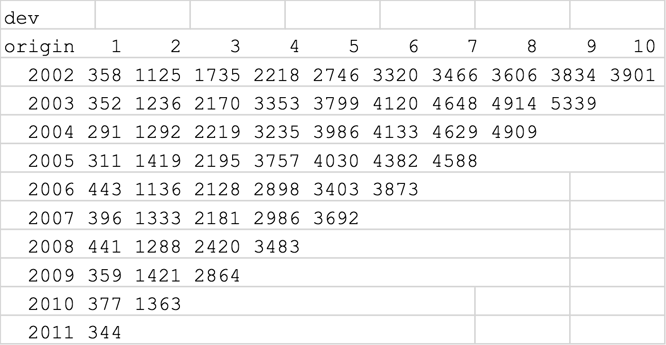
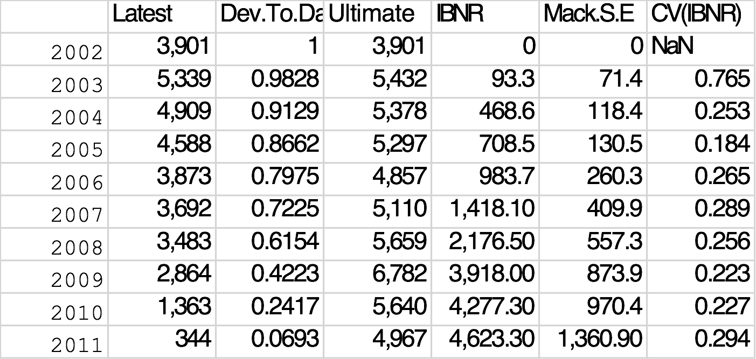
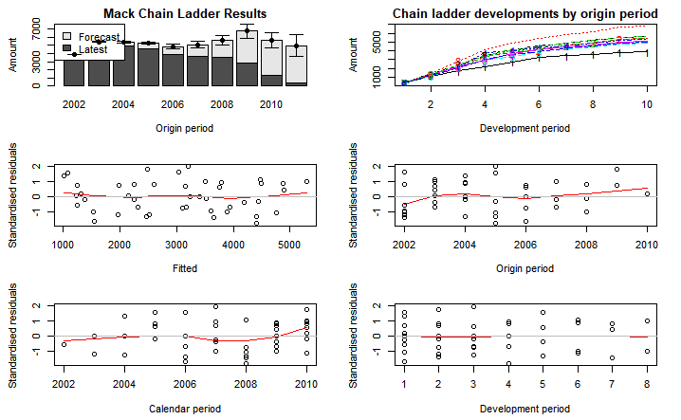
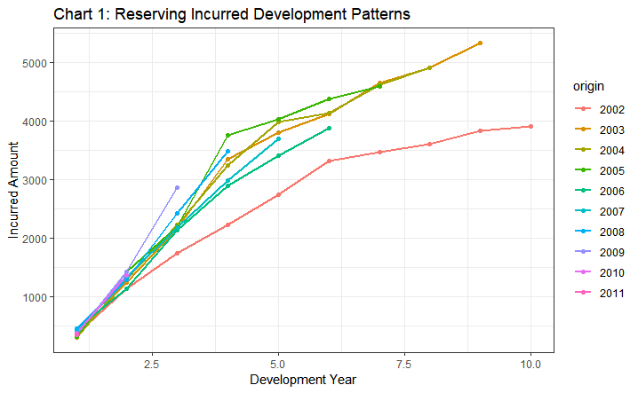
R examples - Reserving ChainLadder
https://gist.github.com/mages/3687713/659b2826d429823ff4ddb139d4d1bf46fe794dac
https://rawgit.com/mages/GIRO2012/master/Using_R_in_Insurance_GIRO_2012.html

Slide 23
R Shiny Dashboard
A quick, powerful way of creating and delivering management information, and a welcome user interface to R
An example : insurance frequency severity simulation tool
https://tychobra.shinyapps.io/freq-sev-claims-sim/
http://shiny.rstudio.com/

Slide 24
Resource and next steps
Type to enter a caption.

Slide 25
Useful R packages/Tools
ChainLadder for reserving triangles and methods
Dplyr for data manipulation and data cleaning
R glm for generalised linear modelling
Leaflet for geographical analysis
Ggplot2 for data visualisation
RMarkdown for reports
KNN for spatial smoothing
XGBoost for pricing and wider regression application
Source data and code : http://r-statistics.co/Top50-Ggplot2-Visualizations-MasterList-R-Code.html#top

Slide 26
Resources
The best way to learn a programing language is to USE IT !
Data Science online course
Google
Keep practising
Kaggle Competition

Slide 27

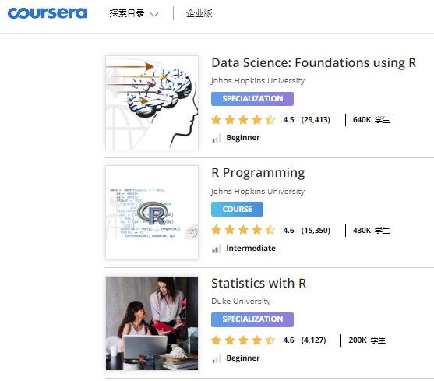
Appendix : Online Resources
Courses to help you get started
DataCamp : Introduction to R (free course)
Coursera : Machine Learning (Andrew Ng)

Slide 28
Appendix : Popular R packages for actuaries
actuar: Loss distributions modelling, risk theory (including ruin theory), simulation of compound hierarchical models and credibility theory
ChainLadder: Reserving methods in R
copula: Multivariate Dependence with Copulas
cplm: Monte Carlo EM algorithms and Bayesian methods for fitting Tweedie compound Poisson linear models
evir: Extreme Values in R
fitdistrplus: Help to fit of a parametric distribution to non-censored or censored data
lifecontingencies: Package to perform actuarial evaluation of life contingencies
lossDev: A Bayesian time series loss development model
mondate: R package to keep track of dates in terms of months

